Slide 1
Phillips and Walls Case Study
ZohoBooks: Empowering Commission-Based Businesses
Discover how Phillips and Walls, a mortgage broker, adapted ZohoBooks to adapt their invoicing process for commission-based revenue.
December 2025

Slide 2
Overview
Phillips and Walls is a mortgage broker. They make their money by taking a commission on the loans, not by selling merchandise at a fixed cost. They needed to adapt their invoices to reflect this payment specificity.
They were able to fix this issue thanks to ZohoBooks and its invoicing module.
Key Takeaway:
ZohoBooks’ flexibility allows businesses from all sectors and with different specificity to use it,
Even companies with variable remuneration can use ZohoBooks and its invoice module.

Slide 3





Meet Phillips and Walls
“We are a trusted Mortgage Brokers with a wealth of experience in the regional mortgage market. We pride ourselves on providing a personal service to each client, focusing on customer service, honesty, and guidance throughout the mortgage process.”
https://pwmb.ae/
Mortgage Broker
26+ Years of Experience
Client Satisfaction
Phillips and Walls is a mortgage broker based in Dubai and in the UK.
It has established presence in both the UK and UAE markets.
Their direct contact with local banks, lenders, and real estate providers gives them an excellent satisfaction rate among their clients.

Slide 4




Pre-ZohoBooks Challenges
Phillips and Walls is a mortgage brokerage firm that specializes in helping clients secure home loans. Unlike businesses that generate revenue by selling physical products at a set price, Phillips and Walls earn their income by receiving a commission on the loans they broker.
This commission is typically a percentage of the total loan amount, which can vary based on the type and size of the loan, as well as the agreements they have with lenders.
To align with this unique business model, Phillips and Walls had to adjust their invoicing system. Traditional invoices, which are often designed for businesses selling goods at a fixed price, don't adequately reflect the commission-based income structure of a mortgage broker.
As a result, they needed to modify their invoices to clearly indicate the commission fees they receive from each loan.
“Dealing with many different banks and their commission percentages and slabs meant we had to tailor our invoice system to accurately invoice the required amount. Any errors would result in incorrect amounts being billed and big delays in receiving funds.”

Slide 5
ZohoBooks: The Tailored Solution
Our ZohoBooks experts took the time to evaluate the case and find a solution to automatize the adjustment of the invoices:
The amount of the loan is now passed as a quantity, as this was a mandatory requirement for a broker’s invoices
The comission is calculated as a rate, named “slab %”, as this was a mandatory requirement for a broker’s invoices
Item Details is now “ Client Name”, as this was a mandatory requirement for a broker’s invoices
Discount is also used and named “ MF 10%”

Slide 6
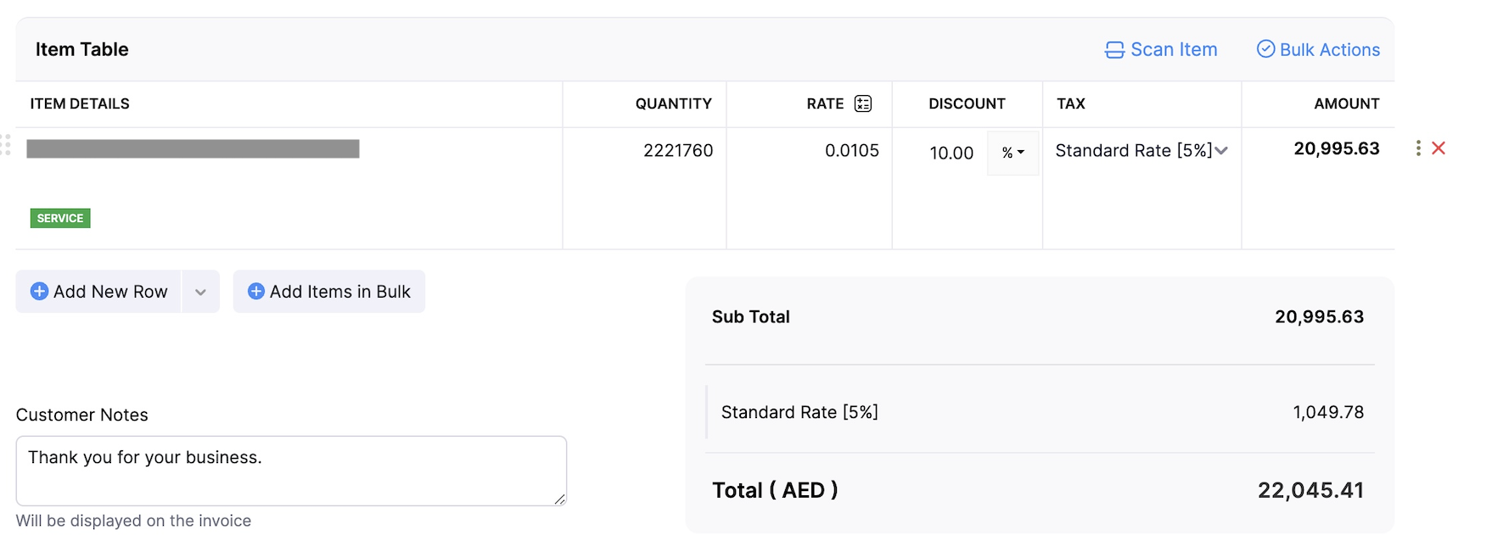
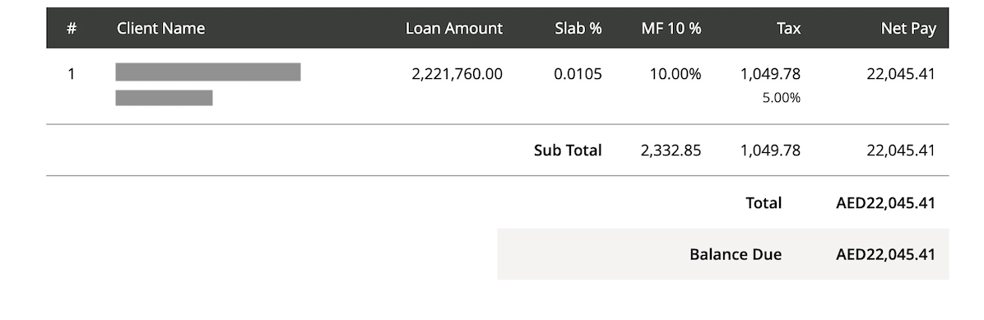
1
Example of the invoice’s fields before (1) and after (2) customization
2

Slide 7
Implementation Process
1
Training
CTC Tax & Accounting provided training sessions for Phillips and Walls team to familiarize them with the new system.
2
Pilot Testing
Before full implementation, a pilot test was conducted with a select group of users and real transactions.
3
Deployment
Once the pilot phase was successful, the solution was rolled out company-wide in the UAE.
4
Monitoring & Optimization
Post-implementation, CTC Tax & Accounting closely monitored the system’s performance and the clients’ feedback to identify areas for improvement.

Slide 8
Result
Time Efficiency
Accuracy and Reduced Errors
Improved Financial Management
Manual calculations for commission-based earnings were complex and time-consuming. Automation eliminated the need for repetitive calculations.
Automation reduced the risk of human error in calculating commissions.
Automated systems generate real-time, detailed reports on commissions and revenues. This enables the finance team to make informed decisions quickly, and ensures that the company remains compliant, reducing legal and financial risks.
Scalability
Faster Invoicing and Payments
An automated system scales effortlessly with increased workload, ensuring smooth operations without the need for additional staff or extended hours.
Automated invoices are generated immediately after a transaction is completed, reducing delays in billing and leading to quicker payments.
We have the confidence that our invoice templates are set up to make the billing process simple and accurate knowing the calculations will be accurate. We are very happy with this set up.

Slide 9
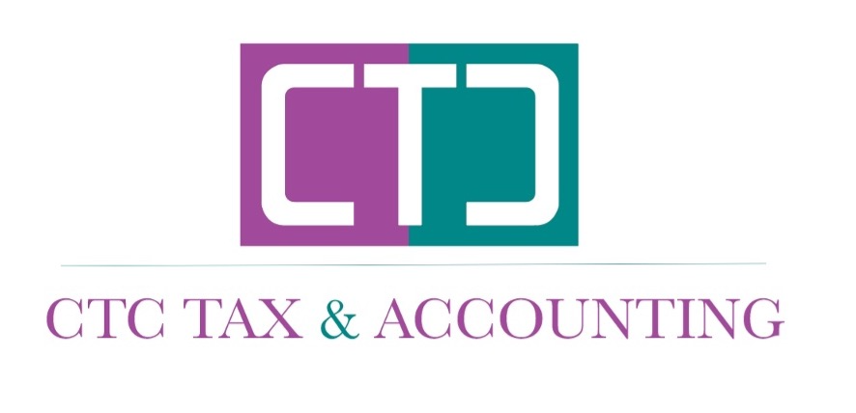
CTC TAX & ACCOUNTING
info@ctconsultancyuae.com
https://www.ctconsultancyuae.com/

